Slide 1
INTRODUCTION
Hello! Greetings to all .I am here to share my insights for the company sales performance for the year of 2011.
I appreciate TATA Group from providing me chance to gain insightful information from the data of store's Performance.
Thanks to CEO & CMO for questions asked to me and provide direction for the insights of the data.

Slide 2
Thought Process
I assure you that I look all the necessary steps to ensure that this analysis is accurate and correct.
I cleaned up the data you provided by removing all the negative values in the Unit Price and Quantity columns and also filtered the data as required for all the visualizations.

Slide 3
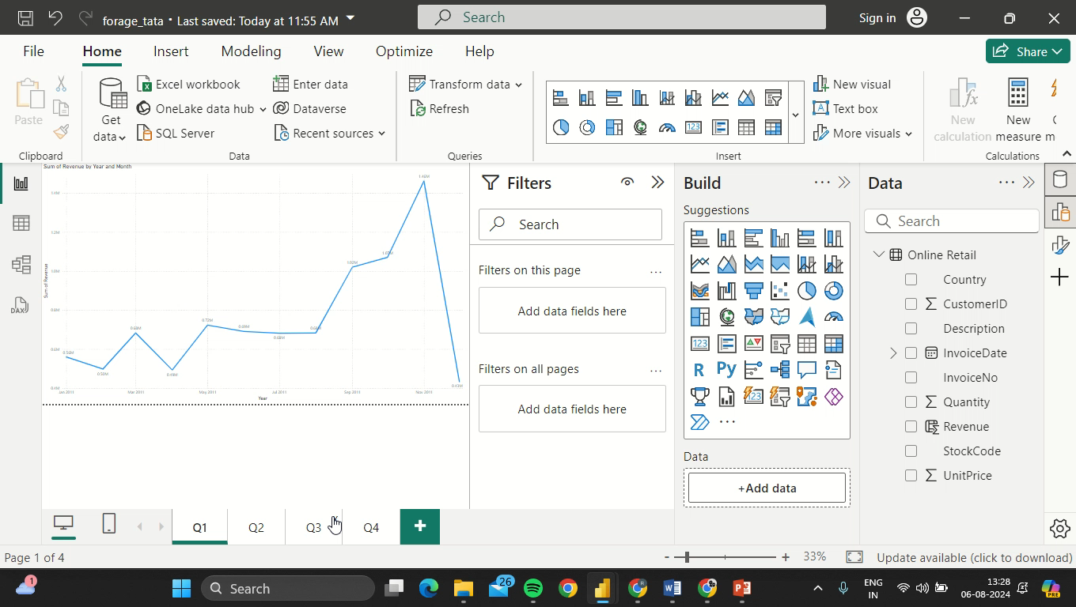

Slide 4
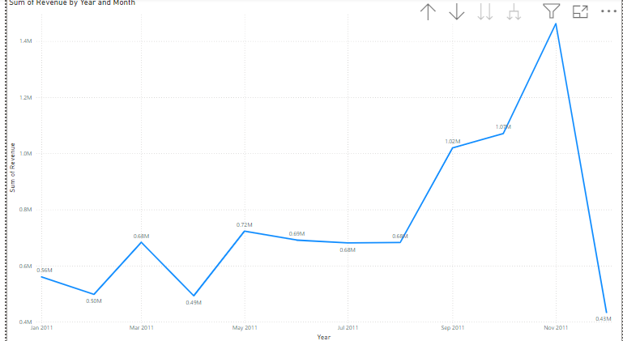
1.
The first 8 months had stable monthly revenue with an average of 685k. The revenue trend from August to December how seasonally affects retail store sales

Slide 5
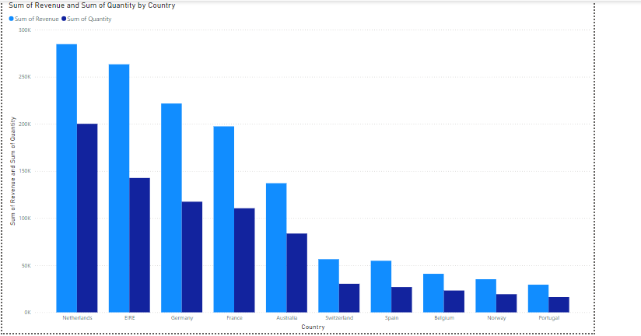
This chart represents the top 10 countries in revenue and the quantities bought in these countries except The United Kingdom
There is no major difference between the revenue and the quantity of goods sold in these countries, showin high purchasing power in these countries

Slide 6
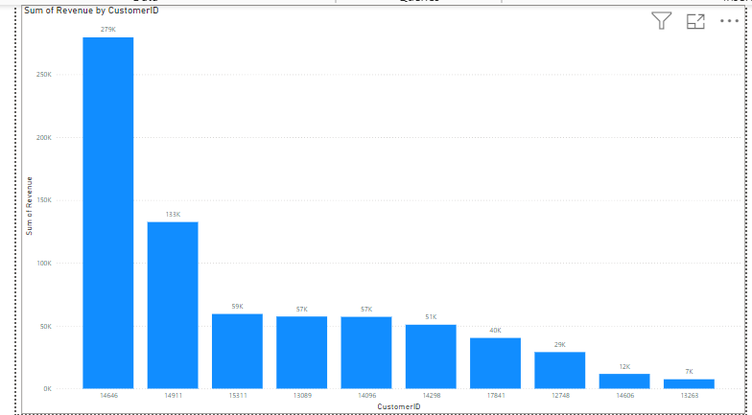
The average difference in revenue between the top 10 countries is 15.8%.The company can aim to strengthen the relationships with these customers to increase customer loyality an retention and ultimately drive more sales and revenue for the company.

Slide 7
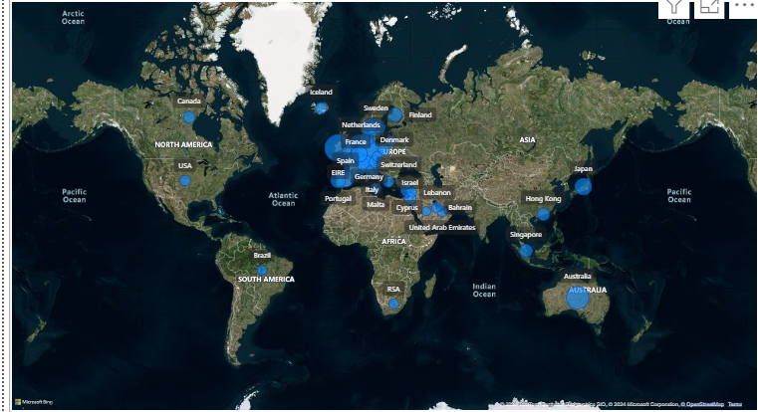
The map chart concludes by comparing the places that have produced the greatest revenue to those that have not.There is no market in Africa, Asia and Russia.The map also reveals that the majority of sales occur only in European ruarket more and dive deeper into these region to maximize sales

Slide 8
Recommendations
The company should come up with strategies that aim at stocking and advertising seasonal products to maximize sales when the demand go up.
The company should create special relationship with the customers who order in big quantities in order to increase the retention
The European market has more potential to grow sales hence company should build strategies to maximize the sales.

